Slide 1

Mitigating the Foreign Body Reaction Associated with LARS Artificial Ligaments Through Delivery of IL-4
Catherine Trojanowski
May 4th, 2021

Slide 2
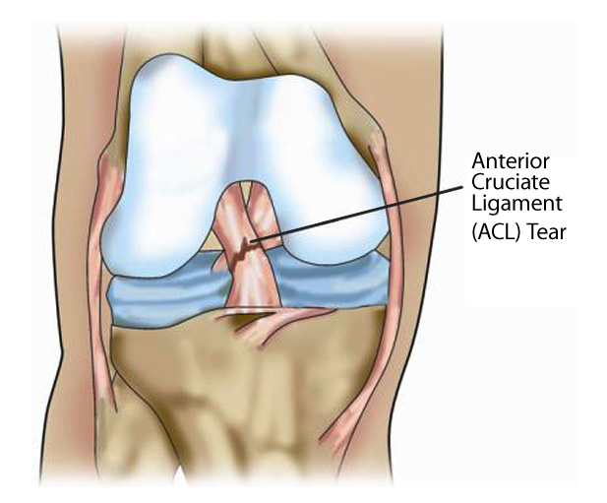
ACL Injuries
The ACL:
  is the most frequently injured ligament in the knee¹
  can be sprained or torn while playing sports that involve sudden stops or changes in direction, jumping, and landing²
  will not heal on its own¹
³
[1] R. Mascarenhas and P. B. MacDonald, “Anterior cruciate ligament reconstruction: a look at prosthetics - past, present and possible future,” McGill J. Med., vol. 11, no. 1, pp. 29–37, Jan. 2008, doi: 10.26443/mjm.v11i1.409.
[2] “ACL injury - Symptoms and causes.” https://www.mayoclinic.org/diseases-conditions/acl-injury/symptoms-causes/syc-20350738 (accessed Feb. 16, 2021).
[3] “Anterior Cruciate Ligament (ACL) – The ultimate guide.” https://ethoshealth.com.au/anterior-cruciate-ligament-acl-ultimate-guide/ (accessed May 1, 2021).

Slide 3
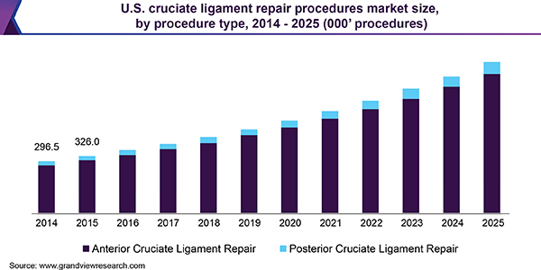
ACL Repair Market Size
Every year, approximately 200,000 to 250,000 ACL injuries occur in the United States⁴
The ACL repair market size is expected to grow exponentially⁵
An estimated 1 billion USD is spent annually on reconstructive surgeries⁶
⁵
[4] N. D. Schilaty et al., “Incidence of Second Anterior Cruciate Ligament Tears and Identification of Associated Risk Factors From 2001 to 2010 Using a Geographic Database,” Orthop. J. Sport. Med., vol. 5, no. 8, Aug. 2017, doi: 10.1177/2325967117724196.
[5] “Cruciate Ligament Repair Procedures Market Size & Share Report, 2025.” https://www.grandviewresearch.com/industry-analysis/cruciate-ligament-repair-procedures-market (accessed Feb. 28, 2021).
[6] A. M. Joseph, C. L. Collins, N. M. Henke, E. E. Yard, S. K. Fields, and R. D. Comstock, “A Multisport Epidemiologic Comparison of Anterior Cruciate Ligament Injuries in High School Athletics,” J. Athl. Train., vol. 48, no. 6, pp. 810–817, 2013, doi: 10.4085/1062-6050-48.6.03.

Slide 4
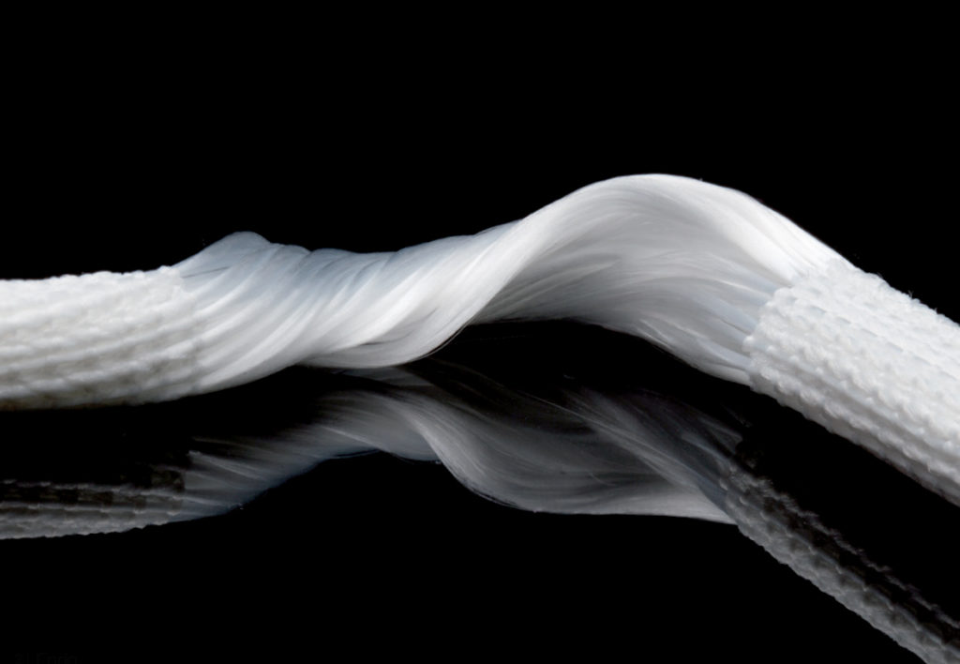
Artificial Ligaments
Advantages of synthetic materials:
  abundant supply and strength
  lack of harvest site pathology
  potential for accelerated rehabilitation⁷
  highly tunable properties⁸
The development of a foreign body reaction restricts artificial ligaments from widespread use⁹
¹⁰
[7] C. Legnani, A. Ventura, C. Terzaghi, E. Borgo, and W. Albisetti, “Anterior cruciate ligament reconstruction with synthetic grafts. A review of literature,” Int. Orthop., vol. 34, no. 4, pp. 465–471, Apr. 2010, doi: 10.1007/s00264-010-0963-2.
[8] B. Corradetti, The Immune Response to Implanted Materials and Devices: The Impact of the Immune System on the Success of an Implant, 1st ed. Switzerland: Springer International Publishing, 2017.
[9] Z. P. Sinagra, A. Kop, M. Pabbruwe, J. Parry, and G. Clark, “Foreign Body Reaction Associated With Artificial LARS Ligaments: A Retrieval Study,” Orthop. J. Sport. Med., vol. 6, no. 12, Dec. 2018, doi: 10.1177/2325967118811604.
[10] “Masterclass: LARS – Part I. A new way forward for ACL reconstruction?.” https://www.sportsinjurybulletin.com/masterclass-a-new-way-forward-for-acl-reconstruction/ (accessed May 1, 2021).

Slide 5
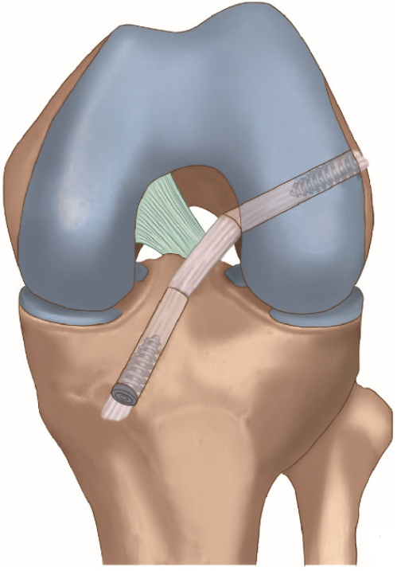
Foreign Body Reaction Associated with LARS Ligaments
The Ligament Augmentation and Reconstruction System (LARS) artificial ligament has been associated with the foreign body reaction⁹
Foreign body giant cells form due to a prolonged presence of pro-inflammatory (M1) macrophages¹¹
Early-stage macrophage polarization towards an anti-inflammatory/regulatory (M2) phenotype mitigates the foreign body reaction¹²
¹³
[9] Z. P. Sinagra, A. Kop, M. Pabbruwe, J. Parry, and G. Clark, “Foreign Body Reaction Associated With Artificial LARS Ligaments: A Retrieval Study,” Orthop. J. Sport. Med., vol. 6, no. 12, Dec. 2018, doi: 10.1177/2325967118811604.
[11] R. Sridharan, A. R. Cameron, D. J. Kelly, C. J. Kearney, and F. J. O’Brien, “Biomaterial based modulation of macrophage polarization: a review and suggested design principles,” Materials Today, vol. 18, no. 6. pp. 313–325, 2015, doi: 10.1016/j.mattod.2015.01.019.
[12] D. Hachim, S. T. LoPresti, C. C. Yates, and B. N. Brown, “Shifts in macrophage phenotype at the biomaterial interface via IL-4 eluting coatings are associated with improved implant integration,” Biomaterials, vol. 112, pp. 95–107, Jan. 2017, doi: 10.1016/j.biomaterials.2016.10.019.
[13] J. Sun et al., “Autografts vs Synthetics for Cruciate Ligament Reconstruction: A Systematic Review and Meta‐Analysis,” Orthop. Surg., vol. 12, no. 2, Apr. 2020, doi: 10.1111/os.12662.

Slide 6
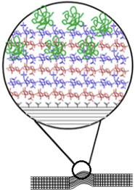
Proposed Solution
The design of current LARS artificial ligaments can be improved by incorporating IL-4, an M2 polarizing cytokine, within a coating made from alternating layers of oppositely charged polyelectrolytes¹²
IL-4
Polyelectrolyte coating
LARS ligament
^{12 (modified)}
[12] D. Hachim, S. T. LoPresti, C. C. Yates, and B. N. Brown, “Shifts in macrophage phenotype at the biomaterial interface via IL-4 eluting coatings are associated with improved implant integration,” Biomaterials, vol. 112, pp. 95–107, Jan. 2017, doi: 10.1016/j.biomaterials.2016.10.019.

Slide 7
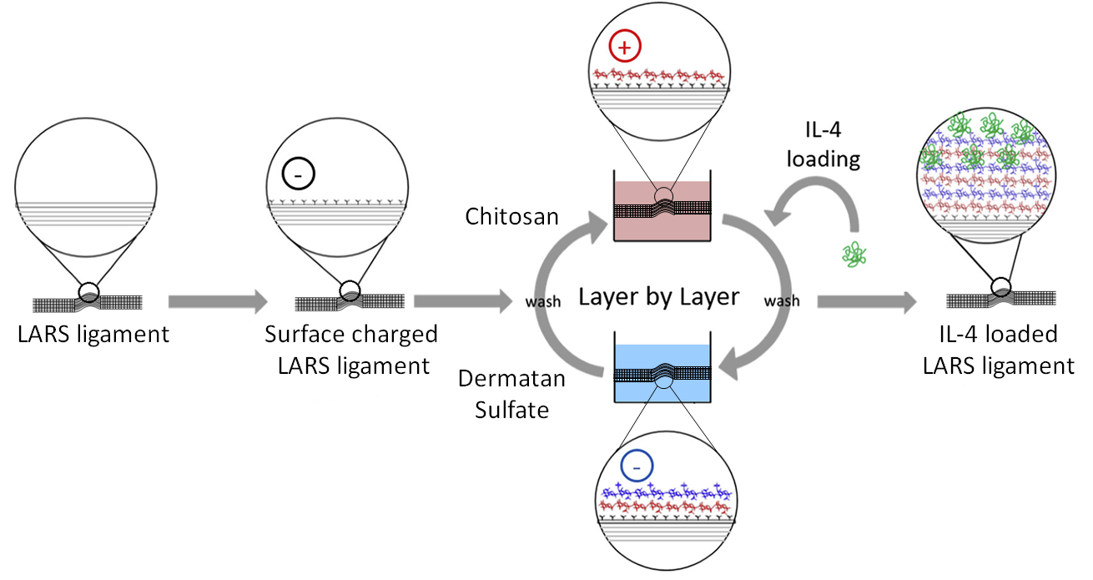
Layer by Layer (LbL) Procedure
^{12 (modified)}
[12] D. Hachim, S. T. LoPresti, C. C. Yates, and B. N. Brown, “Shifts in macrophage phenotype at the biomaterial interface via IL-4 eluting coatings are associated with improved implant integration,” Biomaterials, vol. 112, pp. 95–107, Jan. 2017, doi: 10.1016/j.biomaterials.2016.10.019.

Slide 8
Specific Aims
Investigate techniques for introducing a negative charge onto the surface of LARS ligaments
1
Investigate the characteristics and performance of the IL-4 loaded LbL coating
2
3
Test the performance of IL-4 loaded LARS ligaments in vitro and in vivo

Slide 9
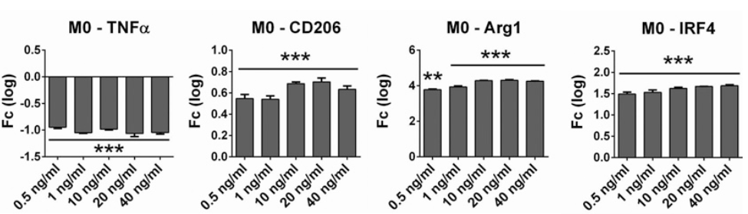
Feasibility
Exposing macrophages to 0.5 ng/mL of IL-4 in vitro caused significant downregulation of TNF-α and upregulation of CD206, Arg1, and IRF4¹⁴
^{14 (modified)}
[14] J. Pajarinen et al., “Modulation of mouse macrophage polarization in vitro using IL‐4 delivery by osmotic pumps,” J. Biomed. Mater. Res., vol. 103, no. 4, pp. 1339–1345, Apr. 2015, doi: 10.1002/jbm.a.35278.

Slide 10
Advantages of Proposed Solution
The IL-4 loaded LARS ligament:
  should foster healing and improve integration into the host tissue¹²
  should result in a lower incidence of post-surgical complications and a quicker patient recovery time
  will give patients another surgical option that can be used to reconstruct the ACL
^{12 (modified)}
[12] D. Hachim, S. T. LoPresti, C. C. Yates, and B. N. Brown, “Shifts in macrophage phenotype at the biomaterial interface via IL-4 eluting coatings are associated with improved implant integration,” Biomaterials, vol. 112, pp. 95–107, Jan. 2017, doi: 10.1016/j.biomaterials.2016.10.019.

Slide 11
Thank You!

